Slide 1
DataFest 2019
The Standard Deviants
Prasidh Arora, David Black, Robert Garrett, Bob Krueger

Slide 2
Fatigue
Performance
[Wellness Survey Data]
[GPS & Accelerometer Data]
Notes:
How fatigued I am affects my performance, and what happens to me during the tournament
What do I say about the data? We can make metrics for fatigue using the wellness data and make metrics for the performance using the gps and accelerometer data.

Slide 3
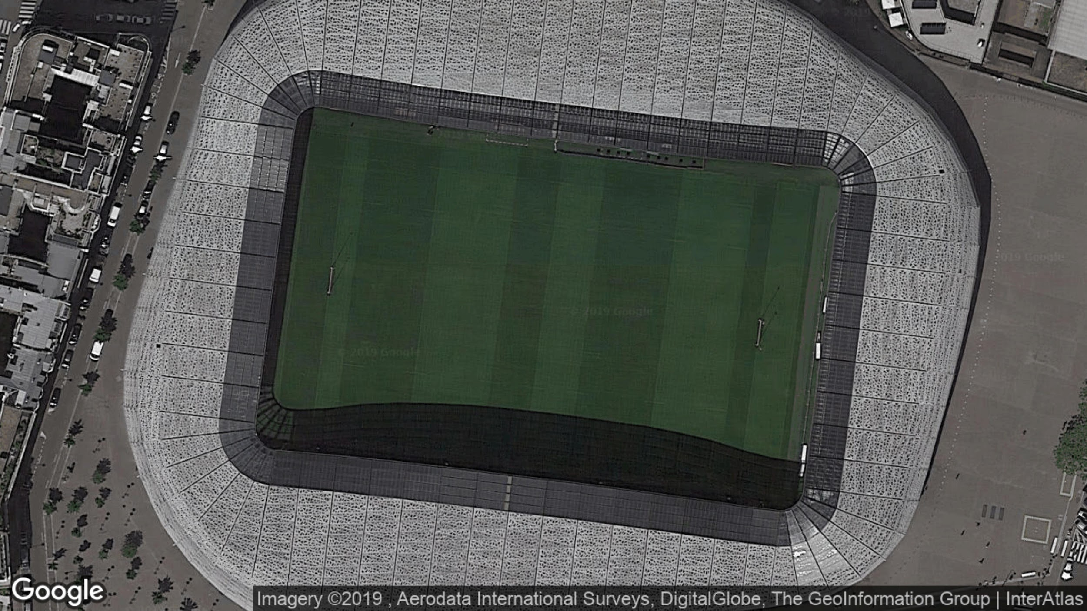
Tournament in Paris
12 Players, 6 Games, 4 Wins
June 8th to June 10th, 2018

Slide 4
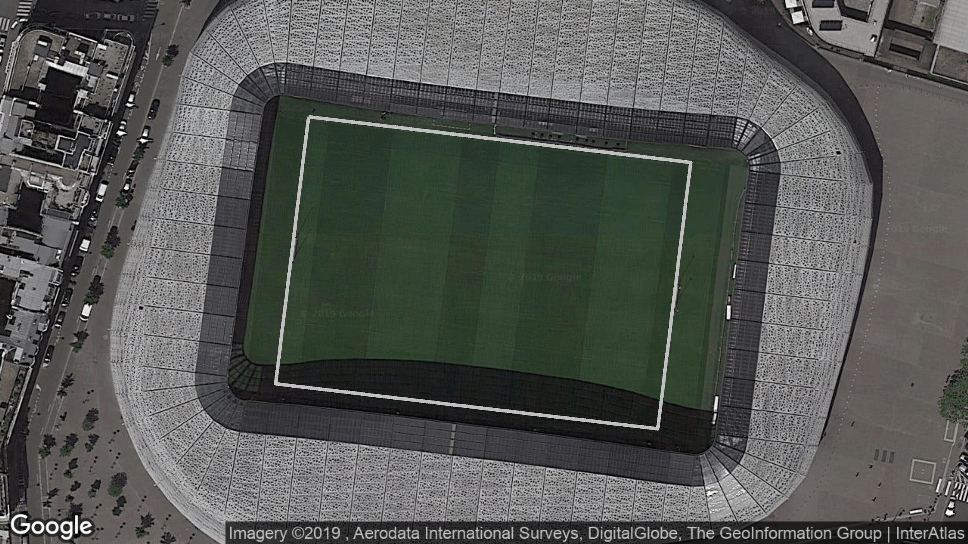

Slide 5
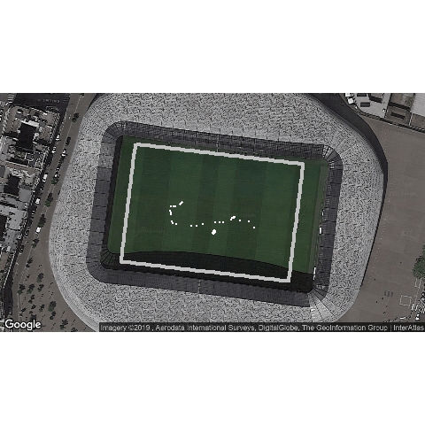

Slide 6
What can we learn from this?
Distance Traveled: 724 meters
Play Time: 7 min, 46 sec
Average Speed: 1.52 m/sec
Notes:
Impose a nice table here

Slide 7
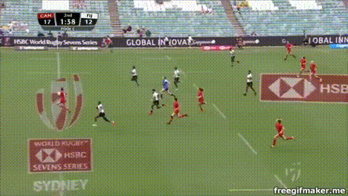
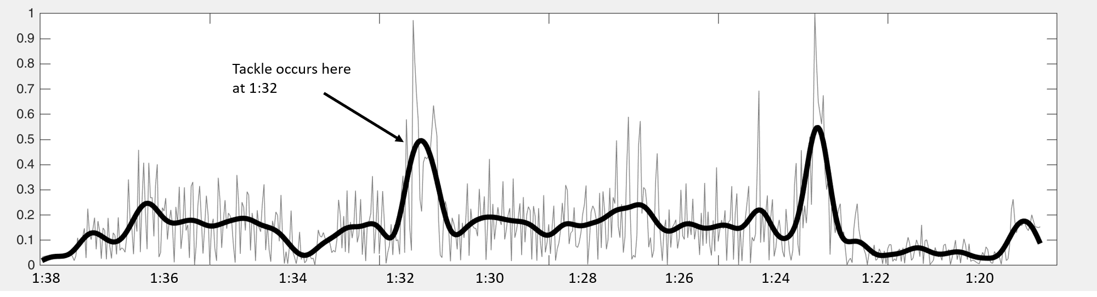
What about Tackles?

Slide 8
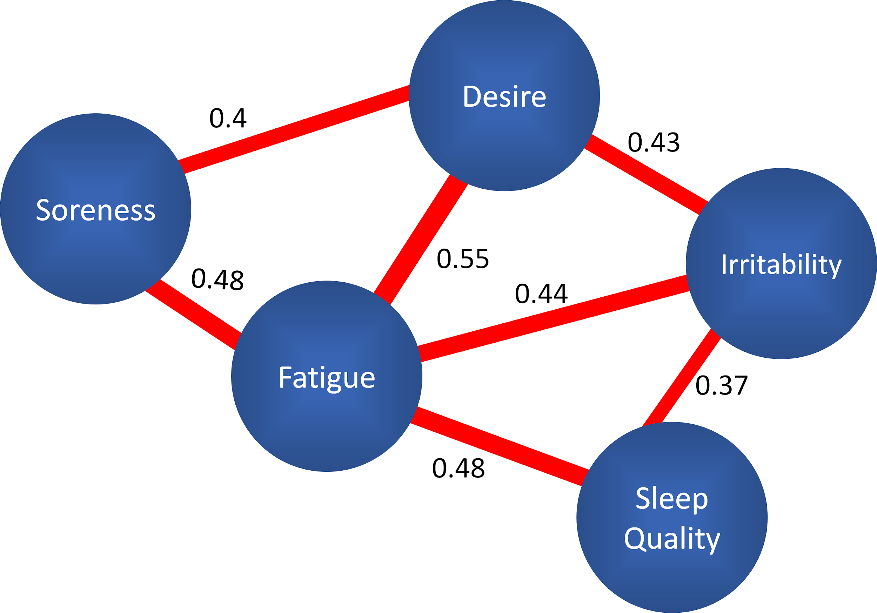
Correlation of Wellness Measures
Monitoring Score:
Sum of Survey Responses,
Ignores Correlation Structure

Slide 9
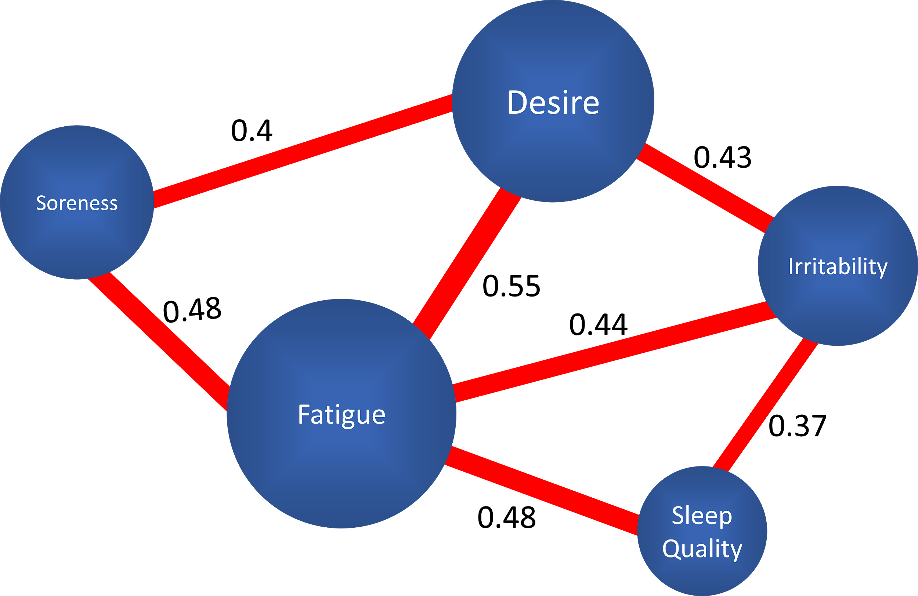
A New Wellness Measure
New Metric:
Normalize by player,
Weight by connection to
Fatigue
Notes:
we can also add other stuff just no connections

Slide 10
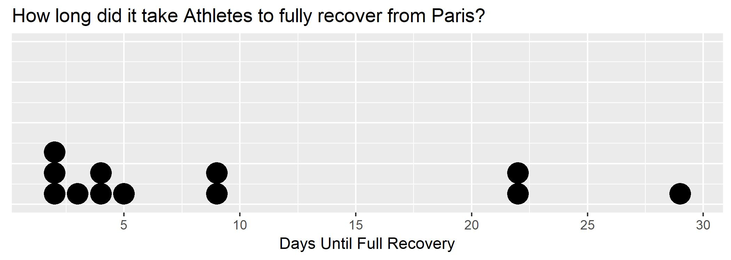
Average Fatigue Score the week before the tournament
vs.
Fatigue Score each day after the tournament
World Cup: 40 days after Paris

Slide 11
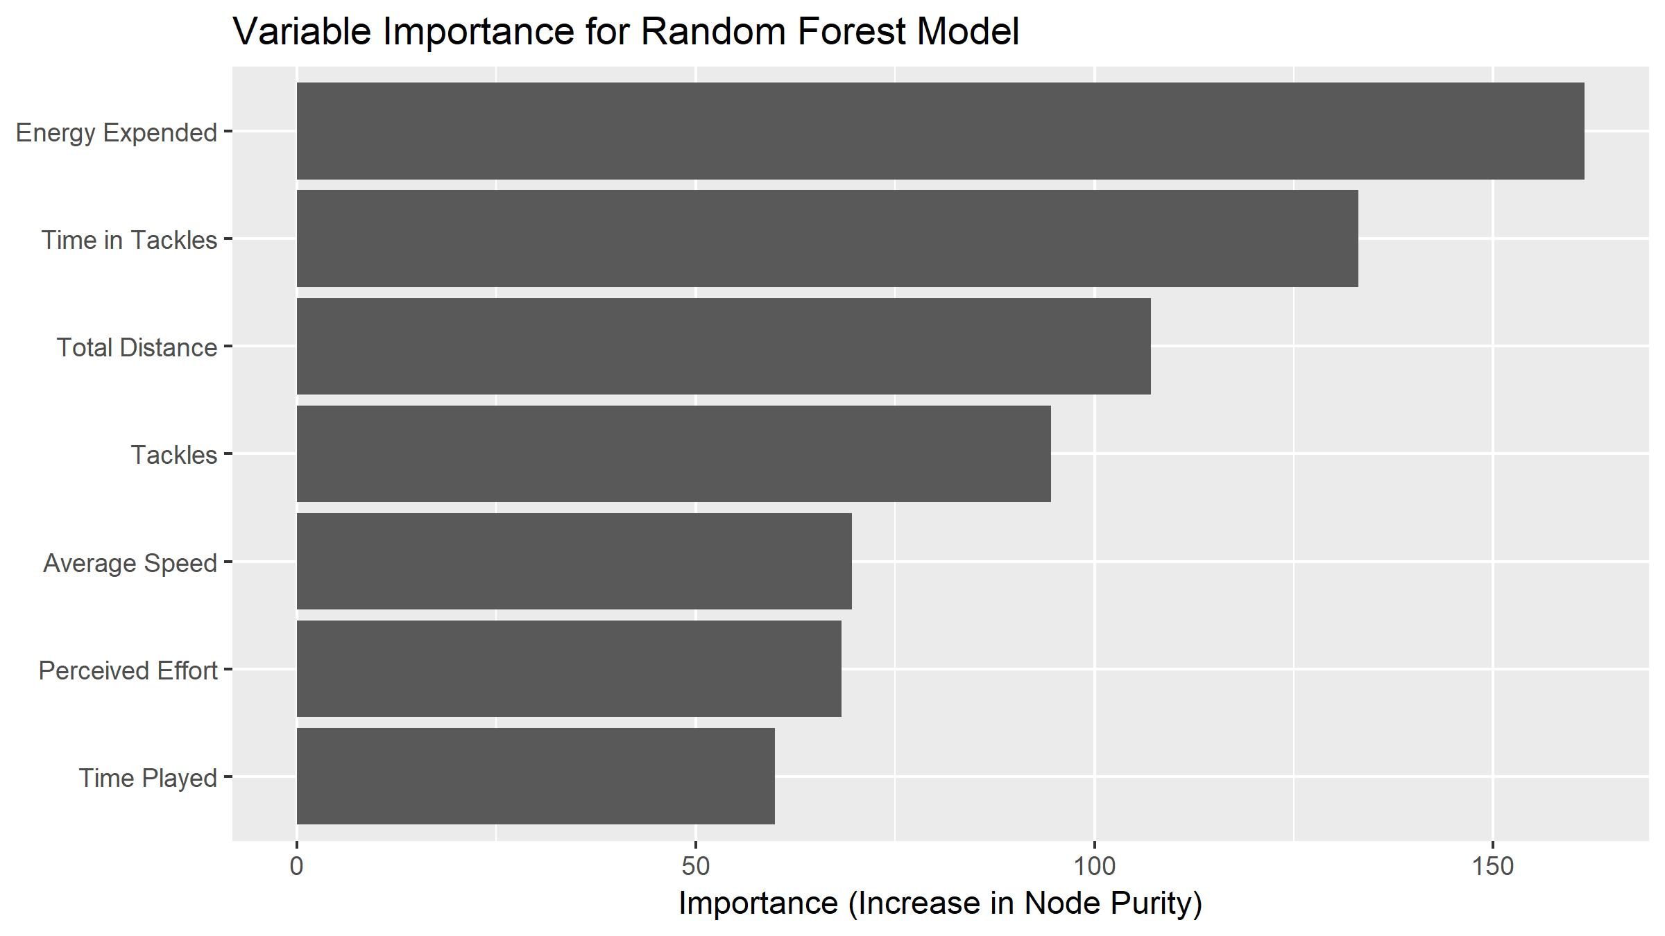

Slide 12

CONCLUSIONS
What we have done:
Identified holistic fatigue (objectively and subjectively)
Quantify recovery between two tournaments
What coaches can do:
Fatigue
Anticipate fatigue to inform workout design
Performance
Better workouts means better recovery
Better recovery means more control over victory

